Slide 1
RWD: Responsive Web Design

Slide 2
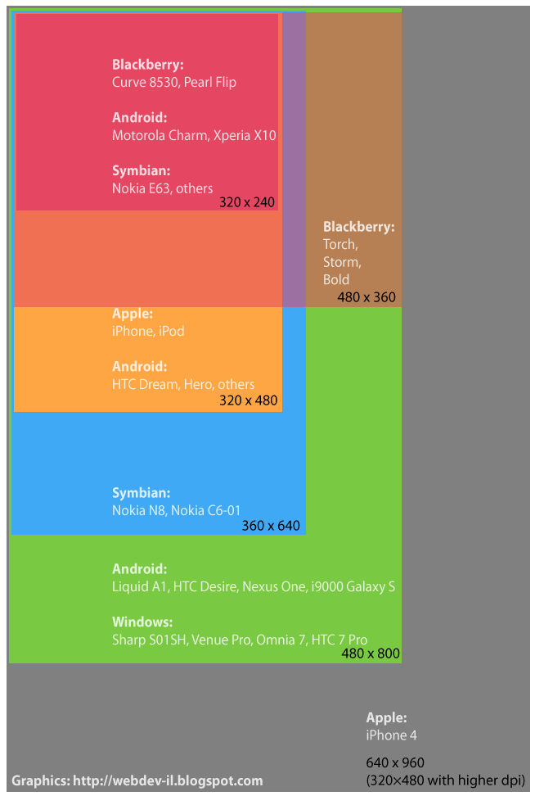
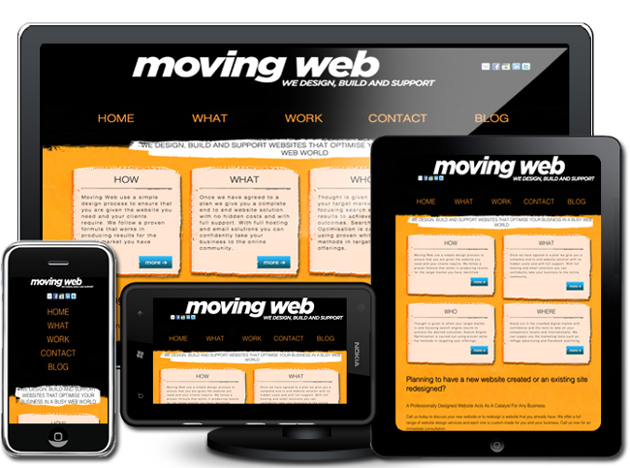

Slide 3
Terms
Media queries
SVG
Responsive
Adaptive/RESS
Dedicated mobile

Slide 4
Media Queries
@media screen and (min-width:500px) {
div#id-name {
property: value;
property: value;
}
}

Slide 5
Media Queries
There are a LOT of mobile devices! ... so ...
There are a LOT of media queries!
http://nmsdvid.com/snippets

Slide 6
Media Queries
Which should you use? Generally, use three breakpoints.
Mobile:
@media screen and (max-width: 740px);
Tablet:
@media screen and (min-width: 741px) and (max-width: 1024px);
Desktop:
@media screen and (min-width: 1024px);

Slide 8
Media Queries
@media cat and (status: grumpy) {
take-photo: yes;
}

Slide 9
SVG
scalable vector graphics
smaller file size
look good on many screens

Slide 10
Responsive
CSS media queries
proportion-based grids
flexible images
Notes:
responds to the layout of the viewing environment, regardless of size of screen

Slide 11
Responsive: Ideal for
informational
promotional
content
newspapers
magazines
blogs
galleries
portfolios
Notes:
responds to the layout of the viewing environment, regardless of size of screen

Slide 12
Responsive Grid Layouts
Responsive Grid System
Bootstrap
Foundation
Unsemantic
Notes:
responds to the layout of the viewing environment, regardless of size of screen

Slide 13
Responsive Examples
microsoft.com
starbucks.com
stuffandnonsense.com
even more: mediaqueri.es

Slide 14
Adaptive/RESS
CSS media queries
proportion-based grids
flexible images
+ device detection
Notes:
it will change to fit a predetermined set of screen and device sizes.

Slide 15
Adaptive/RESS
BBC
slideshare.net

Slide 16
Dedicated Mobile
separate sites
streamlined functionality
Notes:
responds to the layout of the viewing environment, regardless of size of screen

Slide 17
Dedicated Mobile: Ideal for
search
travel
retail
m.facebook.com
m.amazon.com
Notes:
responds to the layout of the viewing environment, regardless of size of screen

Slide 18
Dedicated Mobile Examples
m.facebook.com
m.amazon.com
m.youtube.com
Notes:
responds to the layout of the viewing environment, regardless of size of screen

Slide 19
Responsive Grids
Based on percentages
Have width breakpoints
Should use SVG for images

Slide 20
Resources
Smashing Magazine on mobile screen sizes
A List Apart discussion of RWD
@davatron5000 on Microsoft RWD
Wirefy tutorial

Slide 21
Fundamentals of RWD!: An Example
It's possible to use RWD with WordPress!:
http://www.friarsociety.org
Like all WordPress themes, there's a style.css.

Slide 22
/*
Theme Name: Friar
Theme URI: http://friarsociety.org
Author: Michael Redding
Version: 1.0
Tags: responsive
*/
/** include other CSS files **/
@import url('css/html5-reset.css');
/** specific stylesheets **/
/** mobile **/
@import url('css/mobile.css') screen and (max-width: 740px);
/** tablet **/
@import url('css/tablet.css') screen and (min-width: 741px) and (max-width: 1024px);
/** desktop **/
@import url('css/desktop.css') screen and (min-width: 1025px);

Slide 23
desktop.css
tablet.css
mobile.css
blockquote {
margin: 0 36px;
padding: 0 36px;
border-left: 1px solid #ccc;
}
body div#page-wrapper {
width: 960px;
min-height: 400px;
}
figure,
figure figcaption {
width: 80%;
}
blockquote {
margin: 0 18px;
padding: 0 18px;
border-left: 1px solid #ccc;
}
body div#page-wrapper {
width: 100%;
min-height: 400px;
margin: 0 auto;
}
figure,
figure figcaption {
width: 90%;
}
blockquote {
margin: 0;
padding: 0 12px;
border-left: 1px solid #ccc;
}
body div#page-wrapper {
width: 100%;
margin: 0 auto;
}
figure,
figure figcaption {
width: 100%;
}

